Slide 1
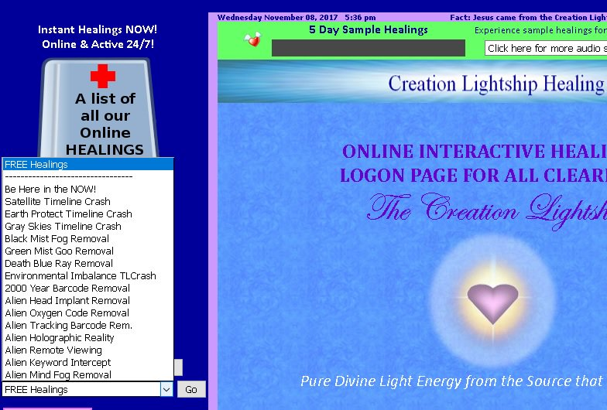
Free Healings

Slide 2
Free Healings

